Slide 1
SAMOS Spectroscopic Pipeline
V1.0
12/19/2024

Slide 2
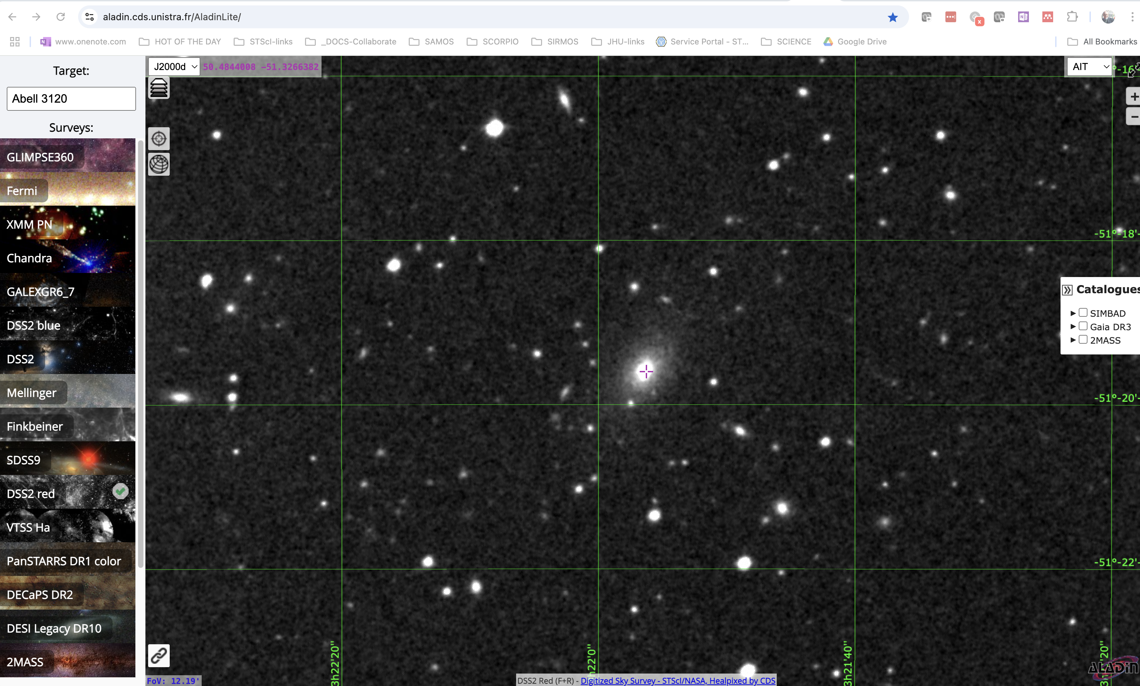
Galaxy Cluster Abell 3120

Slide 3
Preparatory Work
All raw images are collected and organized in directories, one for each night.
Fits headers finalized, as needed
For inspection, a Python script creates “log-books” for both SAMI and SISI images, with basic parameter and image postage stamps, visible as public. html file.

Slide 4
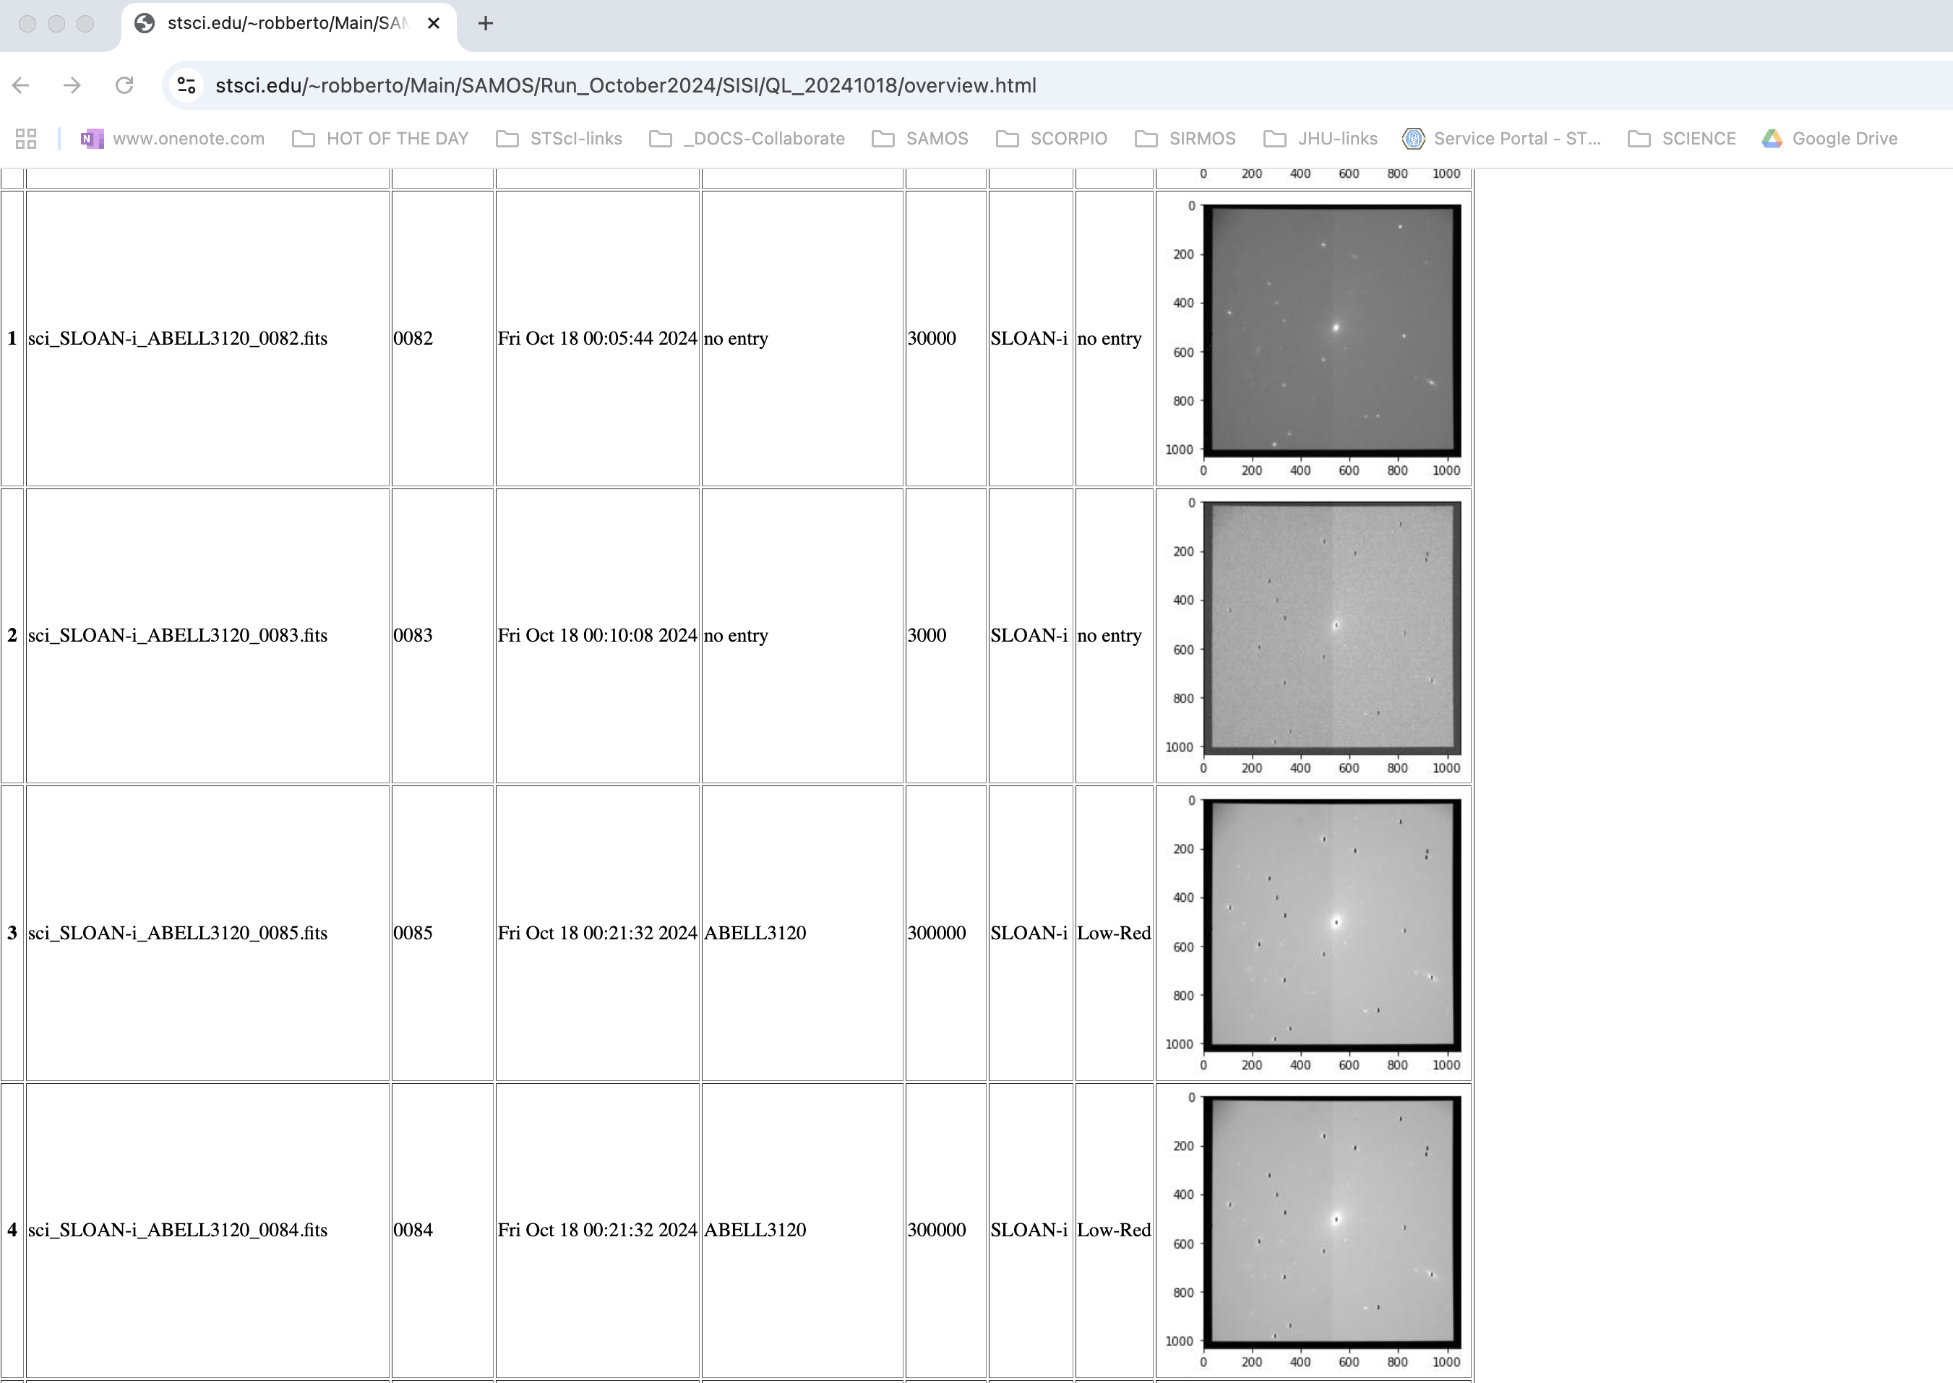
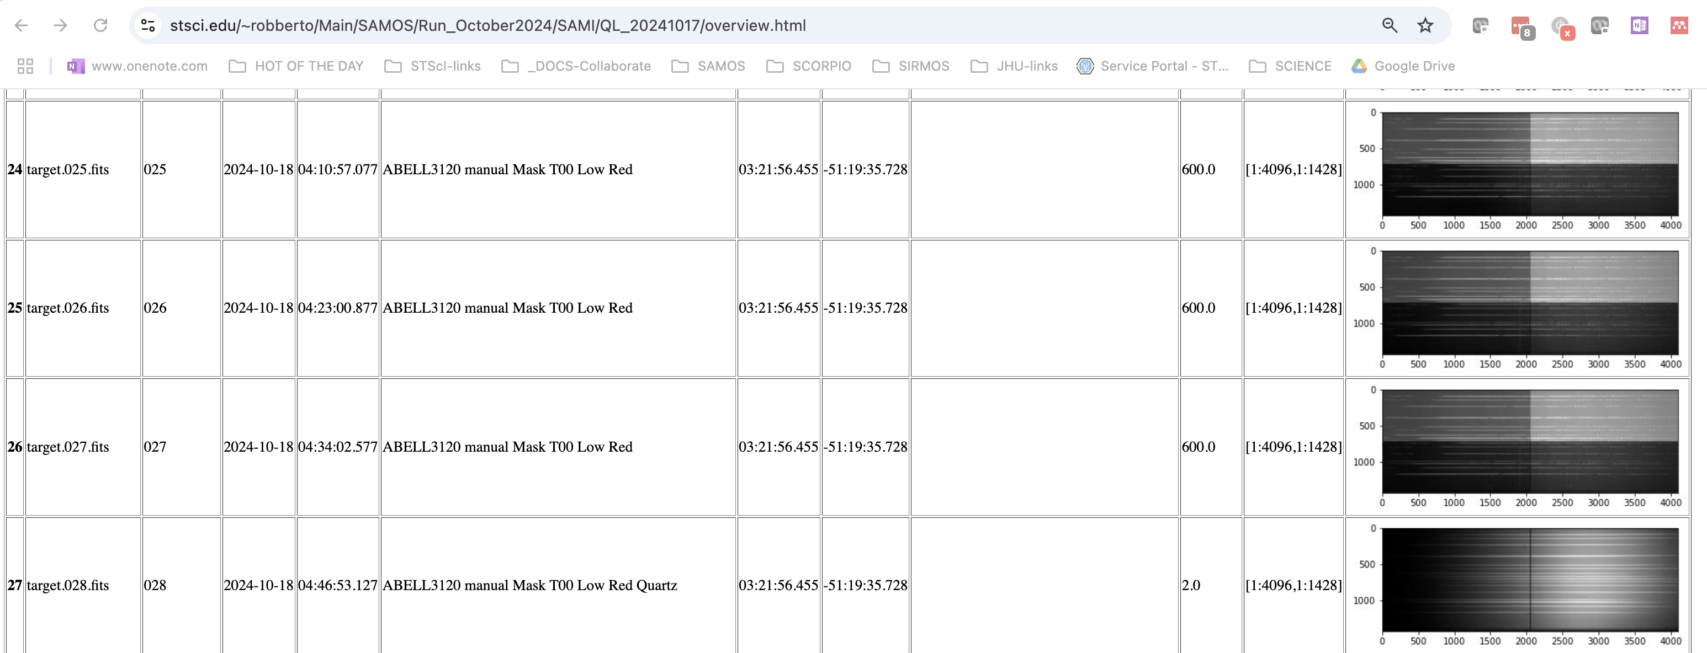
Log book examples

Slide 5
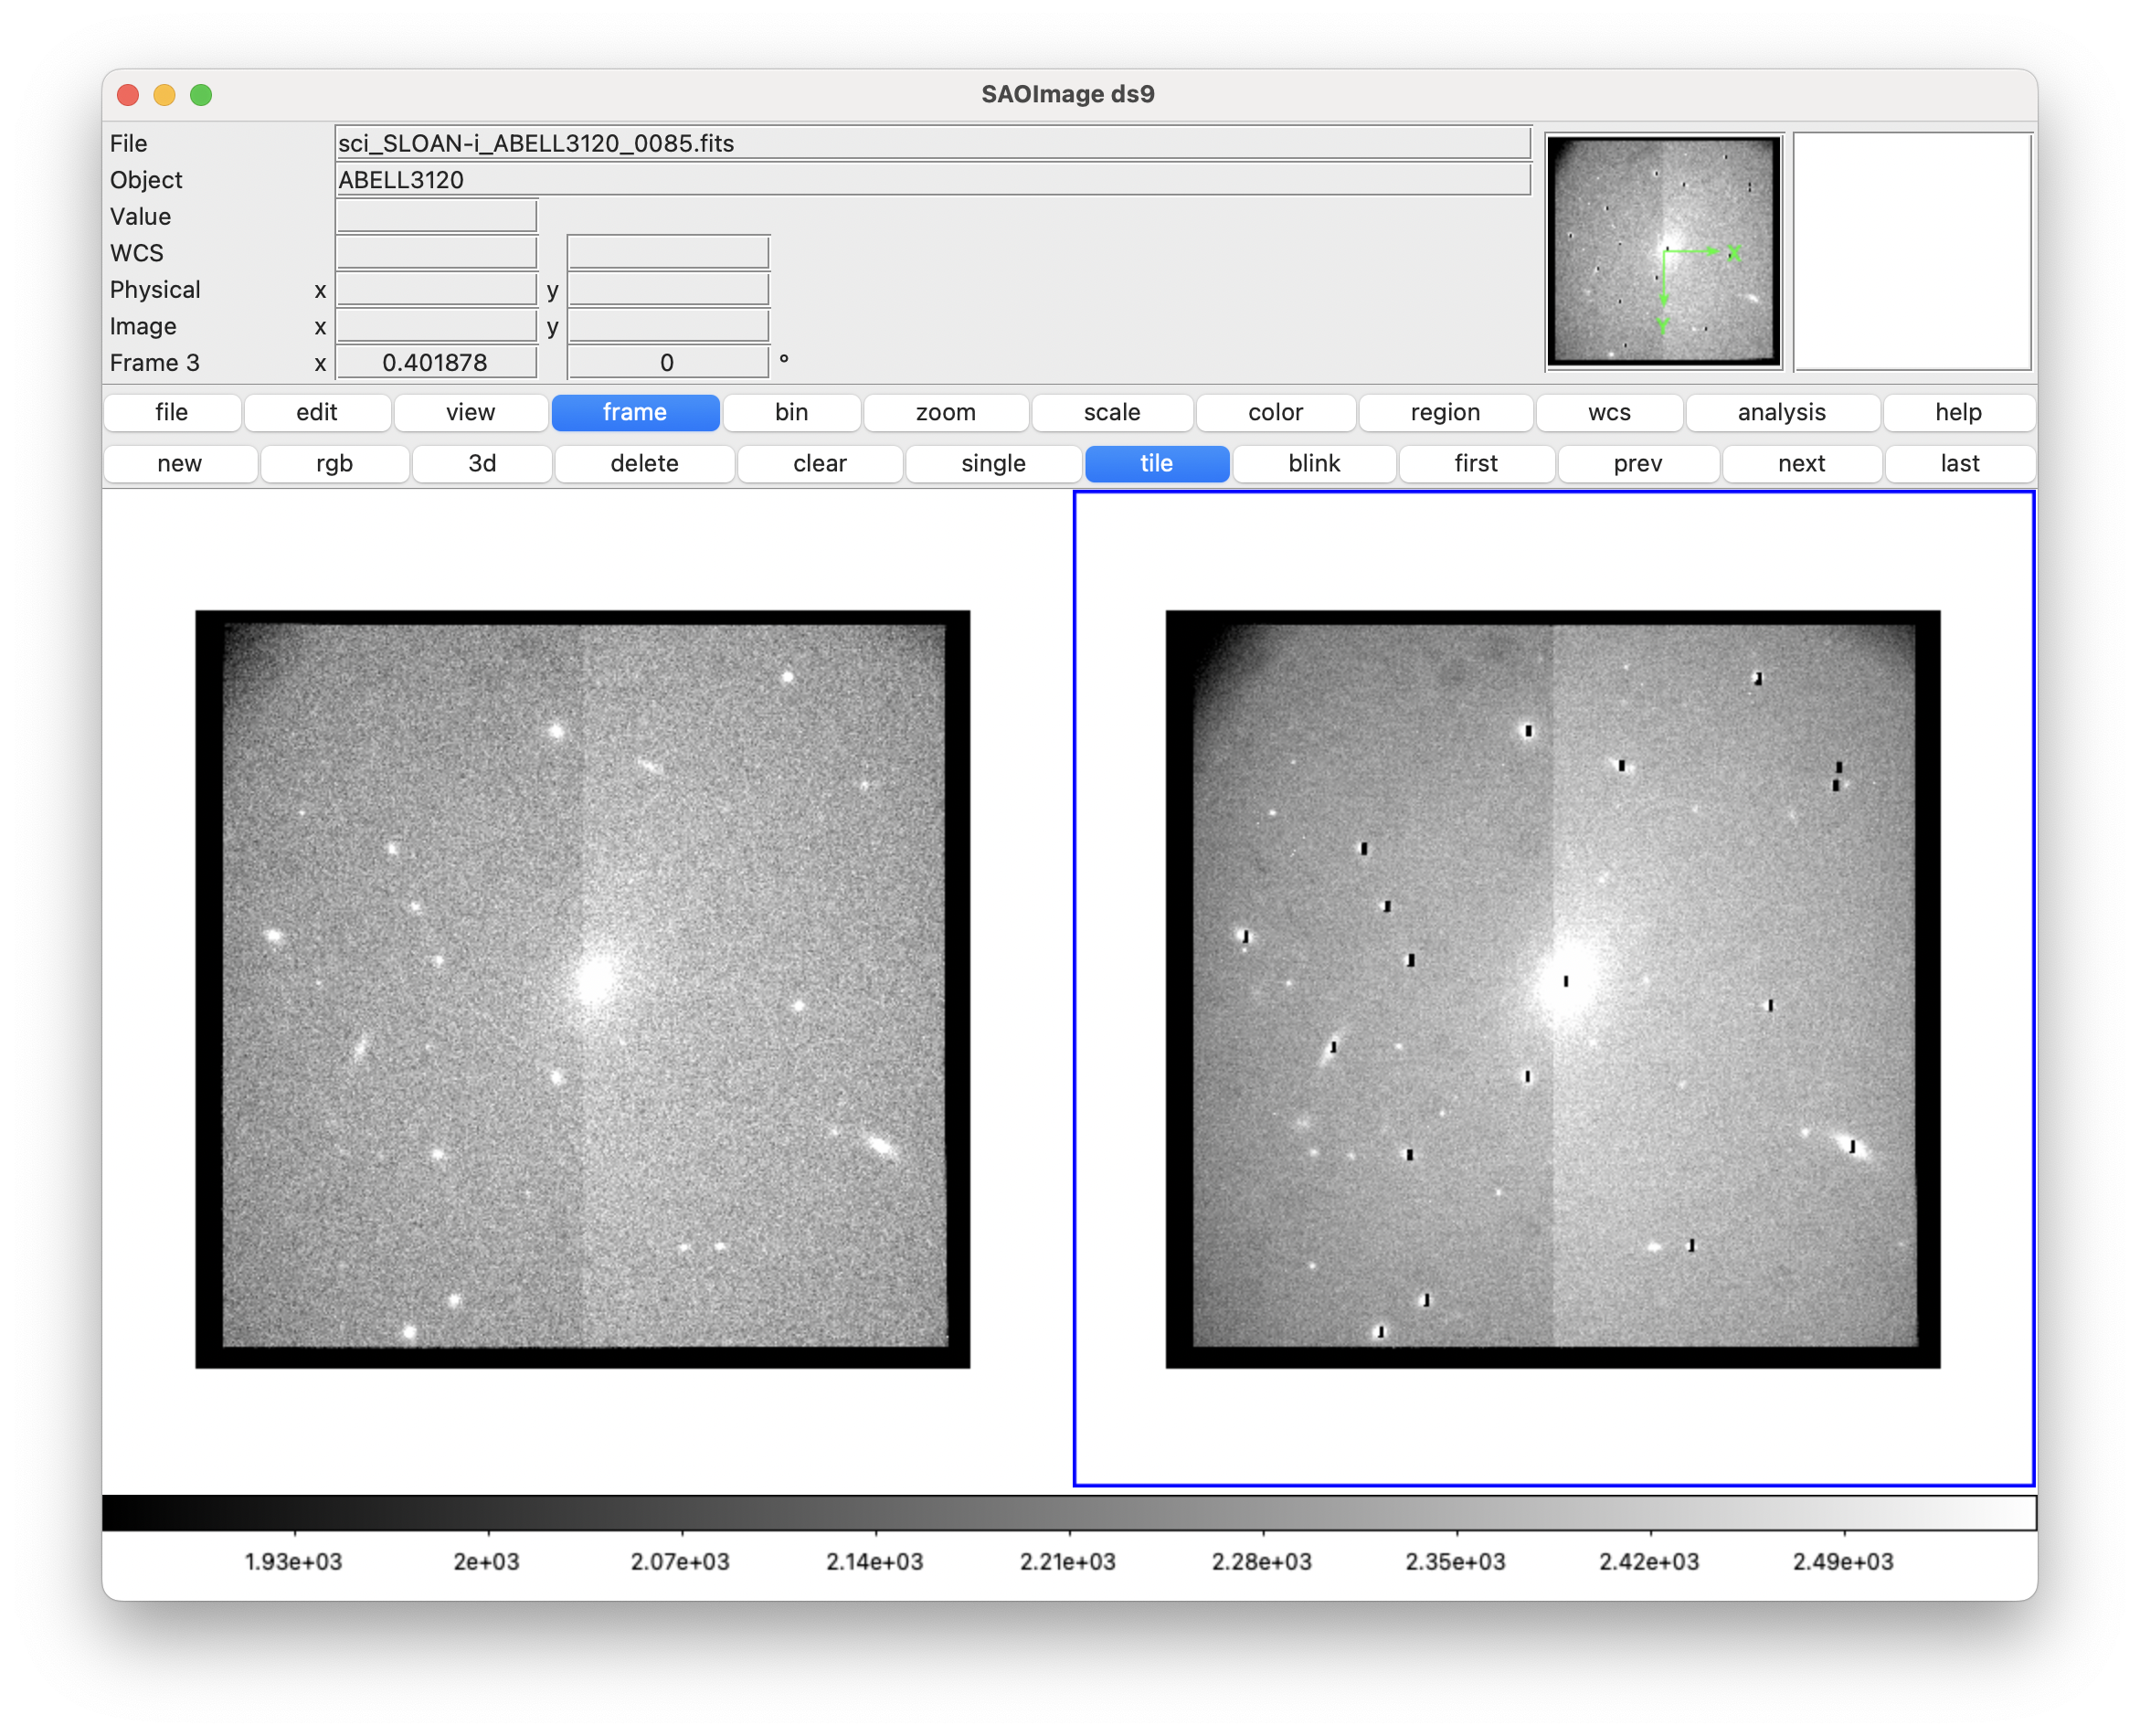
SISI images before/after slit upload

Slide 6
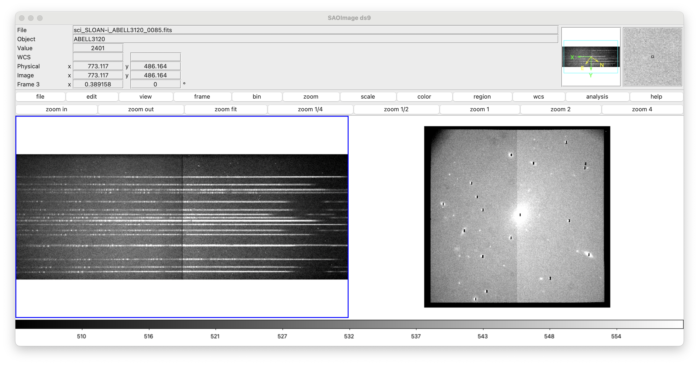
SAMI spectra taken simultaneously

Slide 7
PART 1: full field calibration

Slide 8
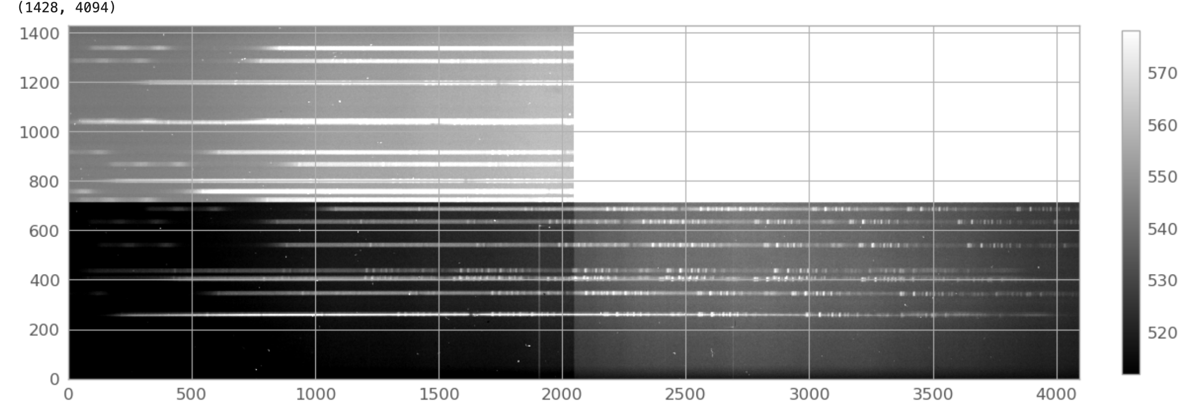
Cleanup: remove cosmic rays (currently uses LA_COSMIC)
Science Frame

Slide 9
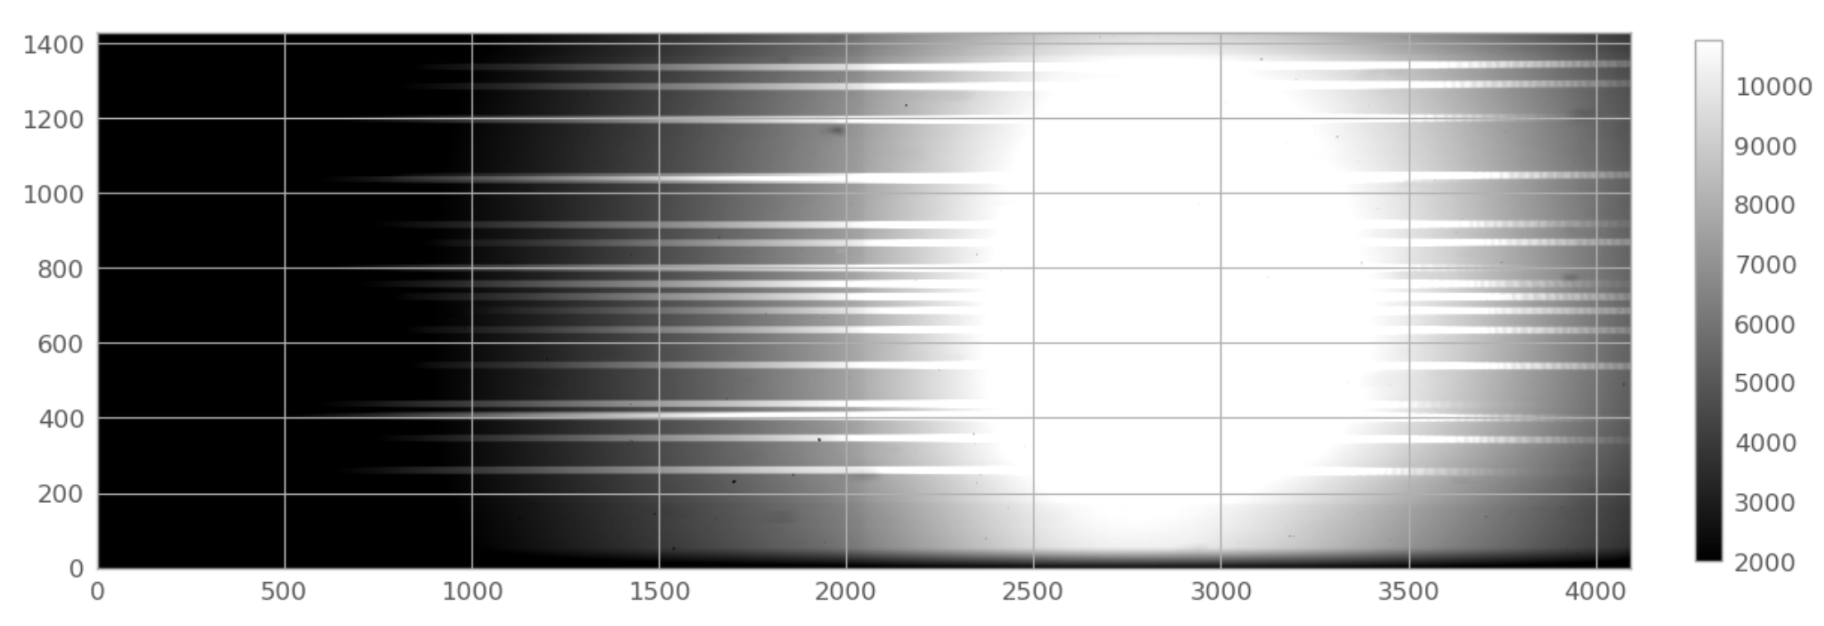
Calibration: remove cosmic rays (currently uses LA_COSMIC)
Flat Frame

Slide 10
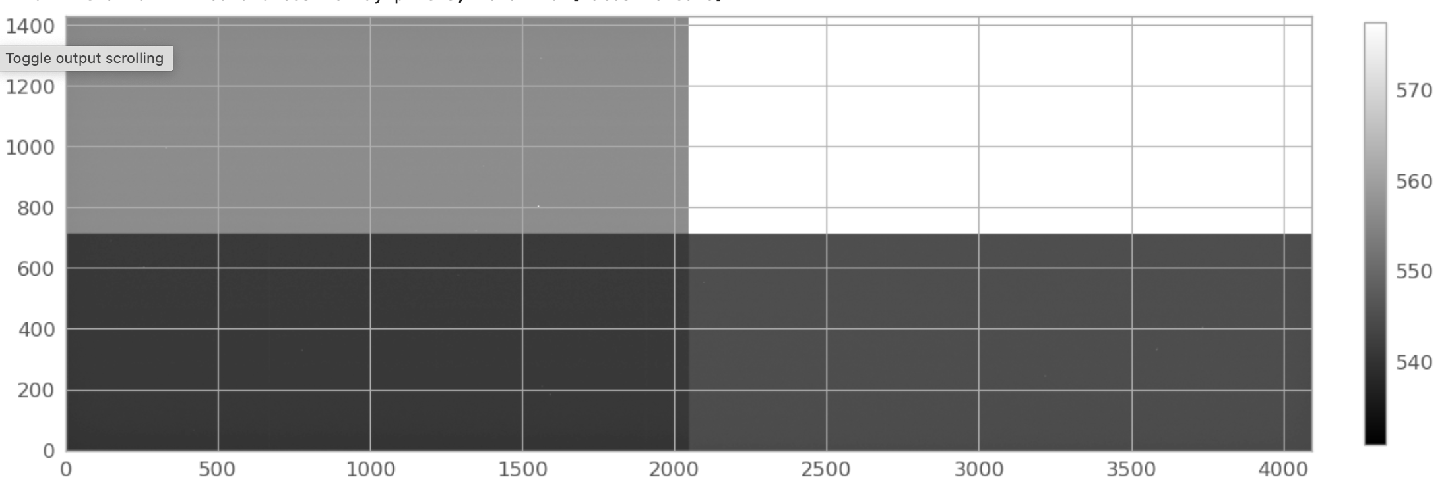
Calibration: remove cosmic rays (currently uses LA_COSMIC)
Bias Frame

Slide 11
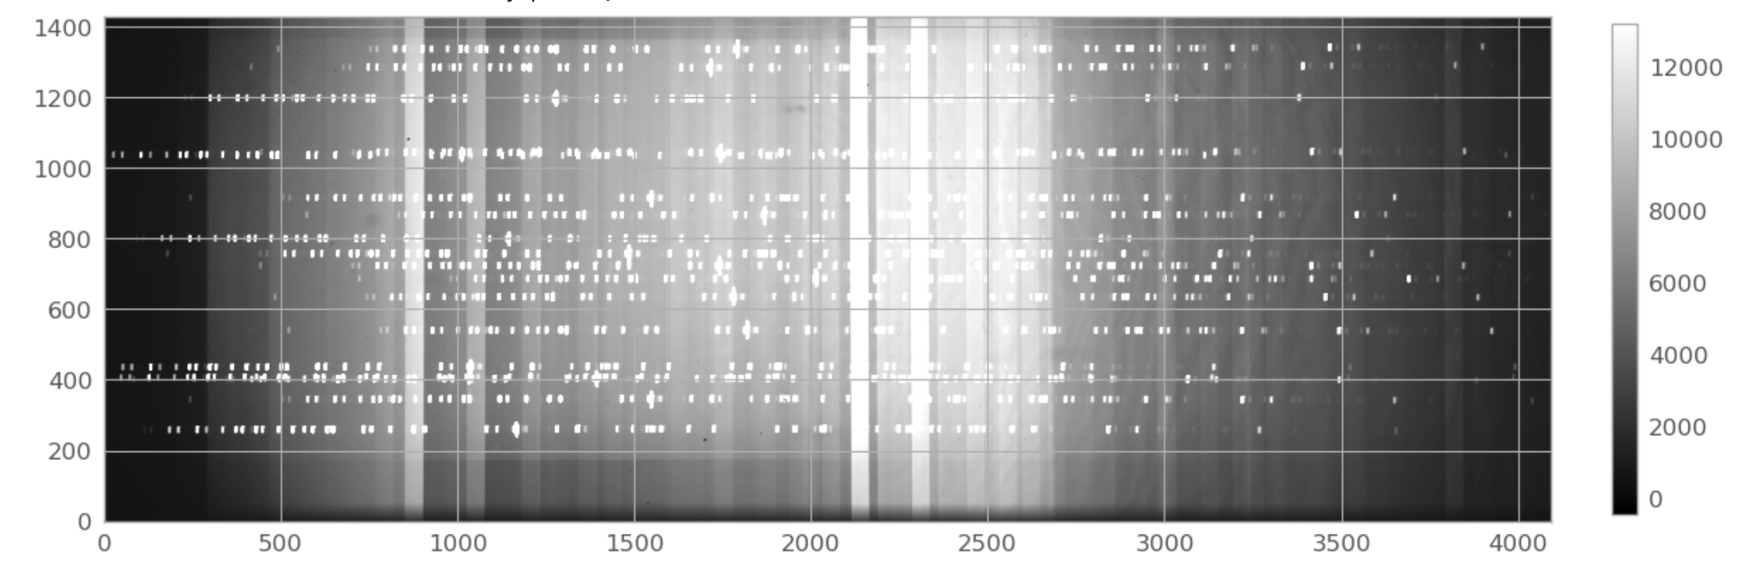
Calibration: remove bias
Arc Frame
stray light from blasting cal.source

Slide 12
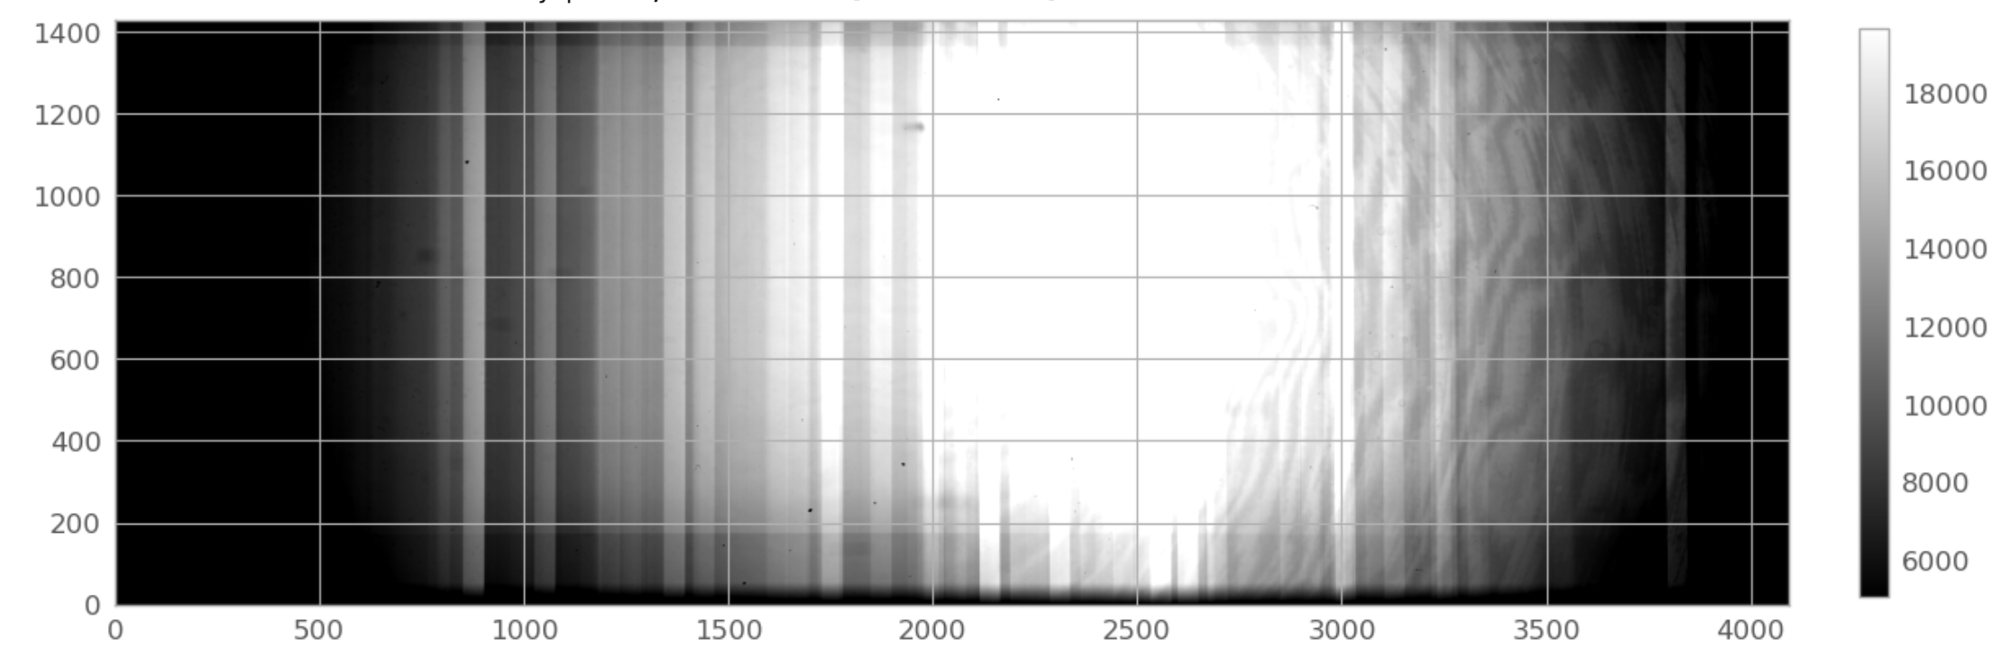
Calibration: remove cosmic rays (currently uses LA_COSMIC)
Arc Frame
Stray light, no slits

Slide 13
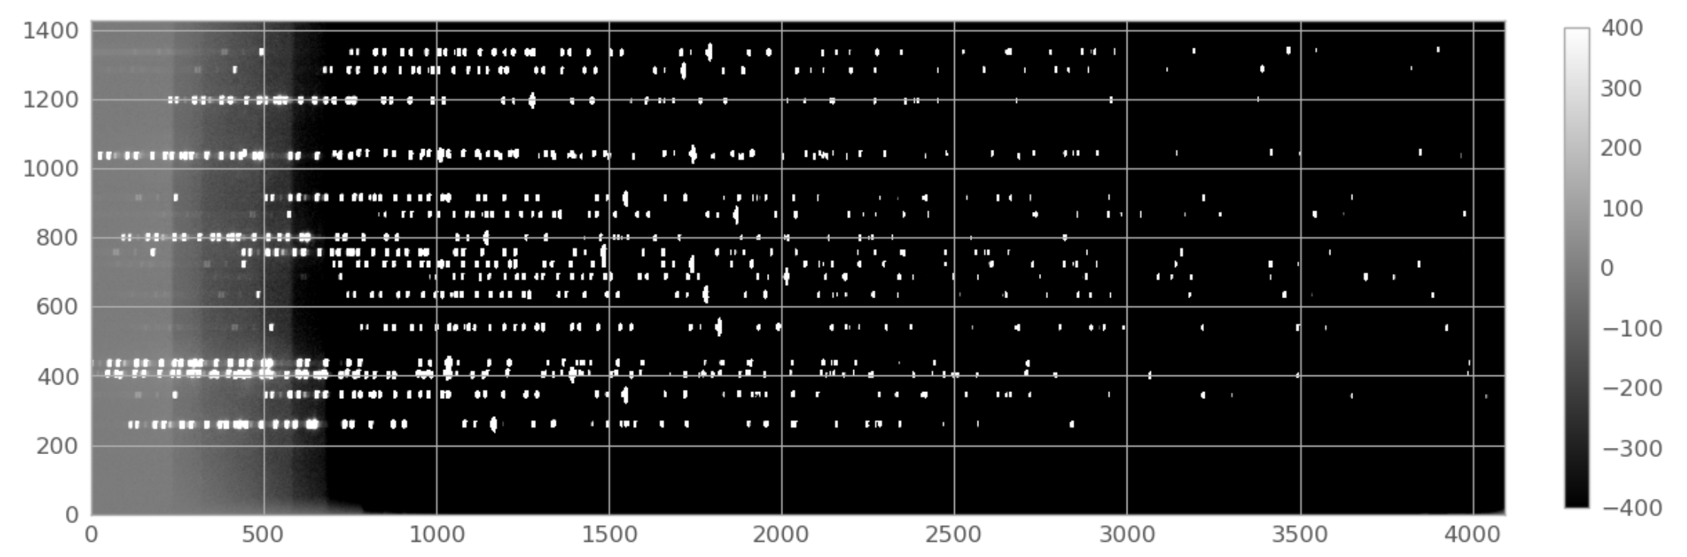
Calibration: remove cosmic rays (currently uses LA_COSMIC)
Arc Frame
after stray light subtraction

Slide 14
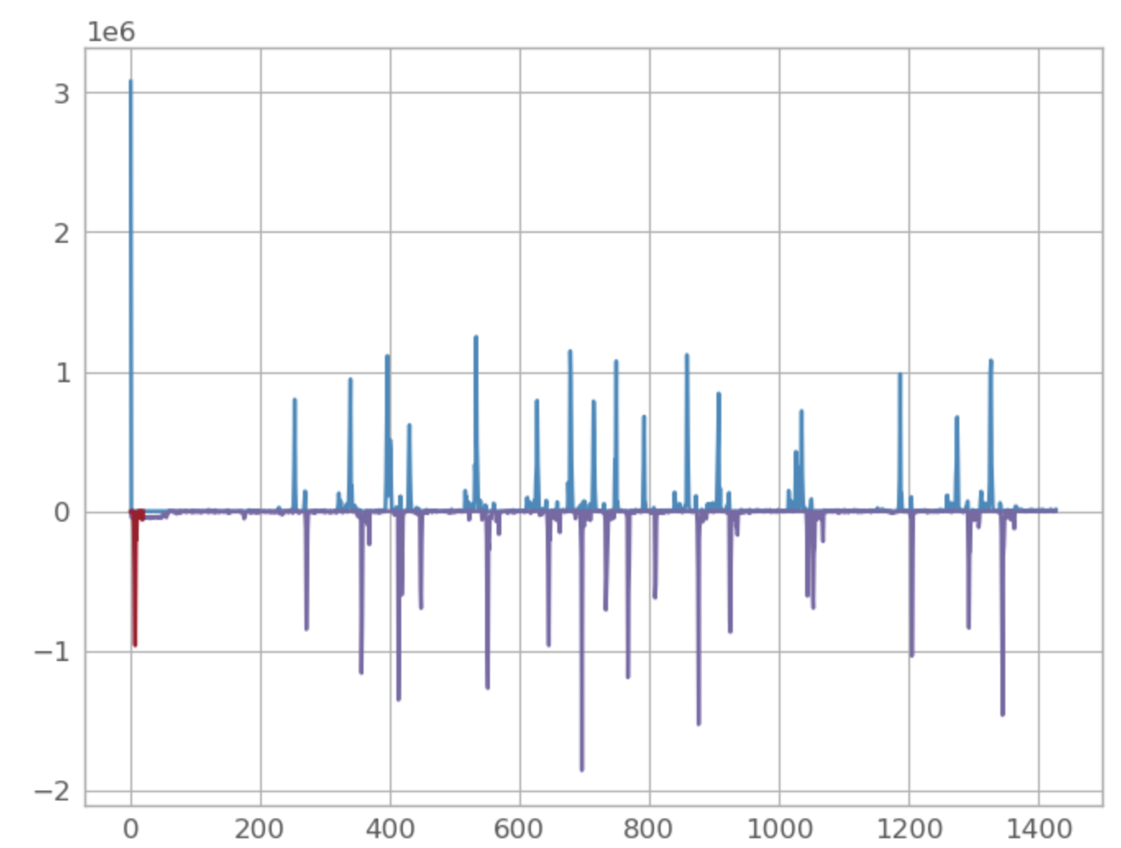
Use shift & diff to find edges of traces
at center field, uses arc frame

Slide 15
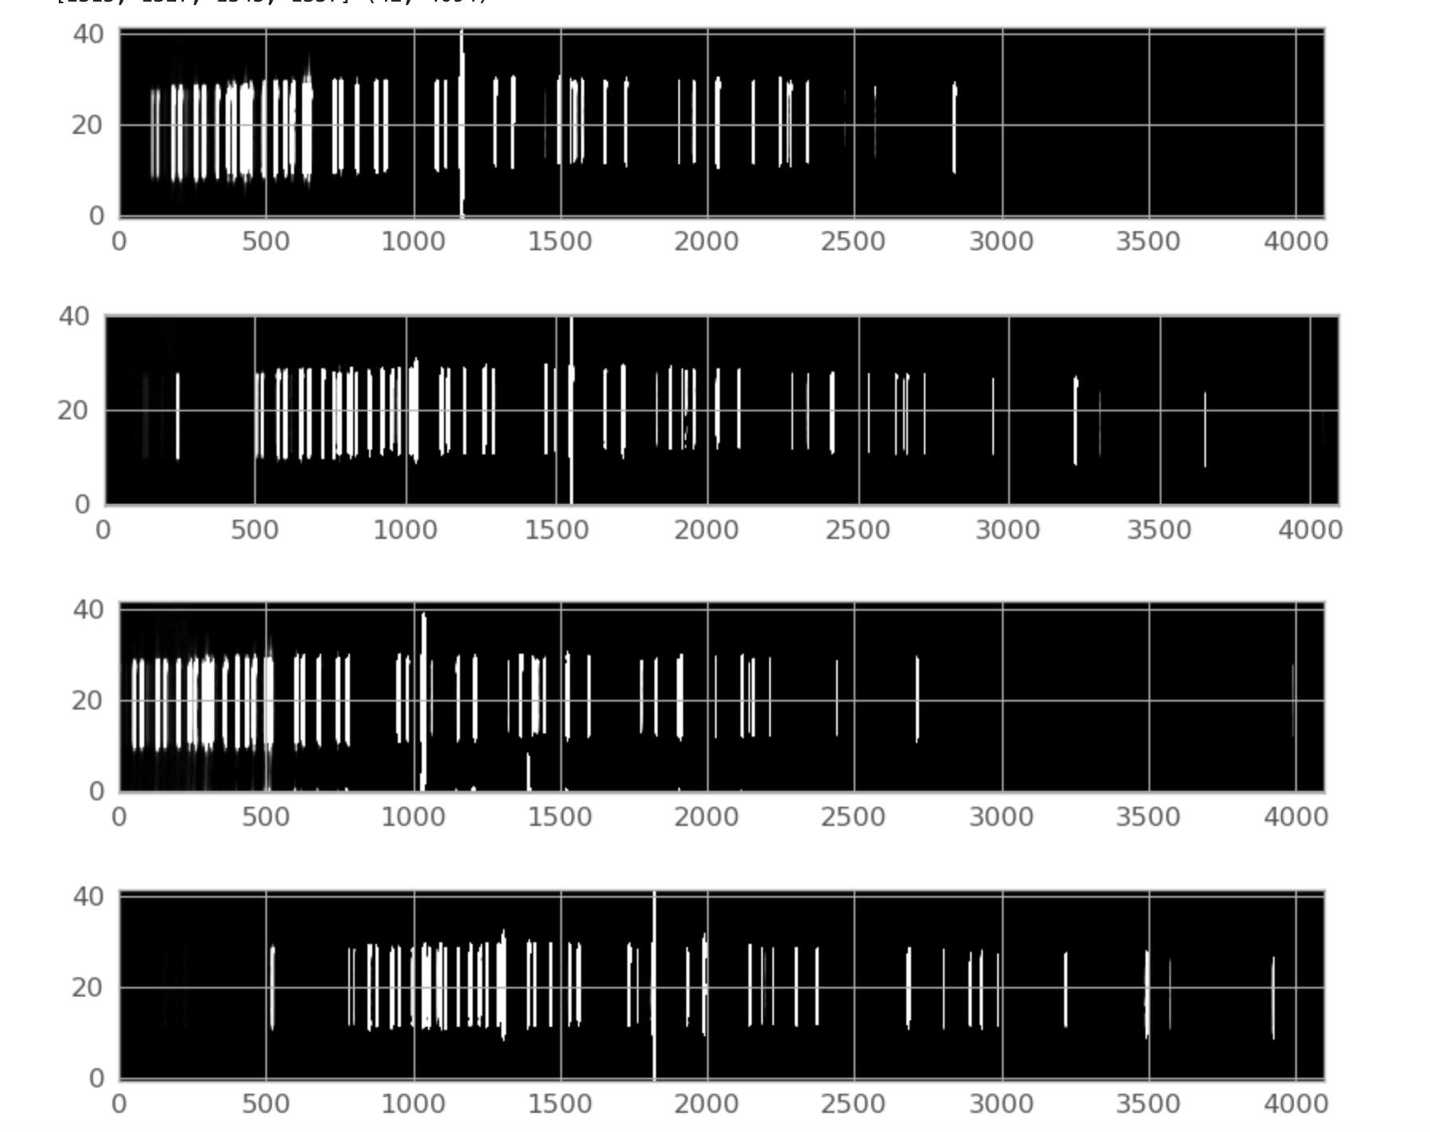
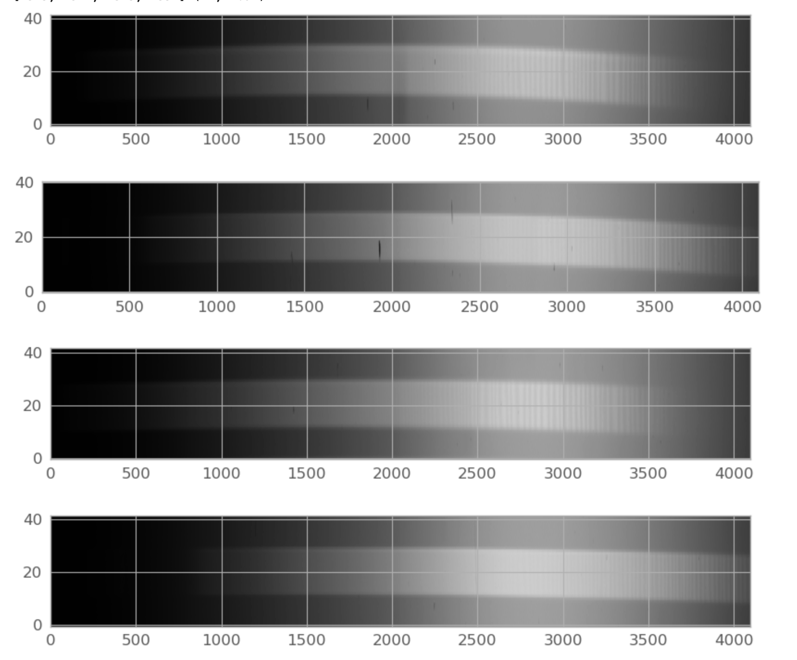
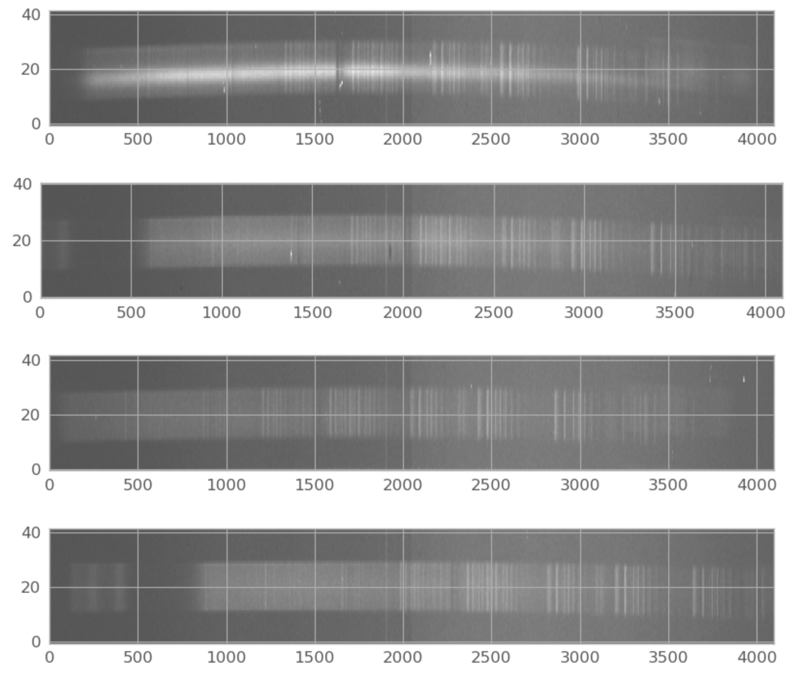
Extract the 2d spectra…

Slide 16
PART 2: process individual strips
Iterative process, one example shown

Slide 17
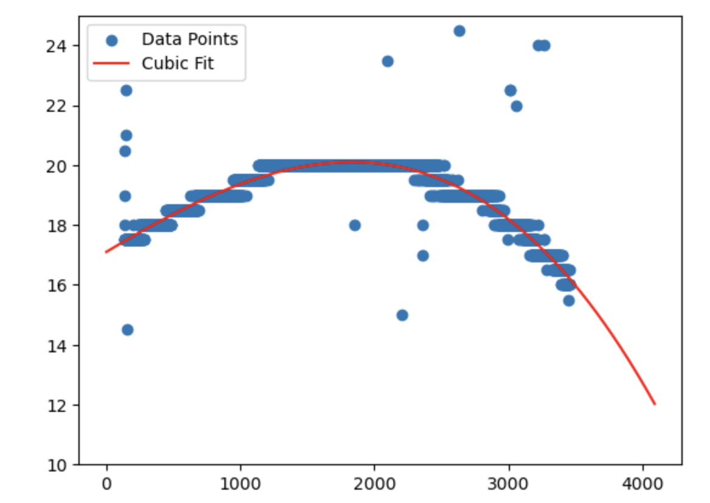
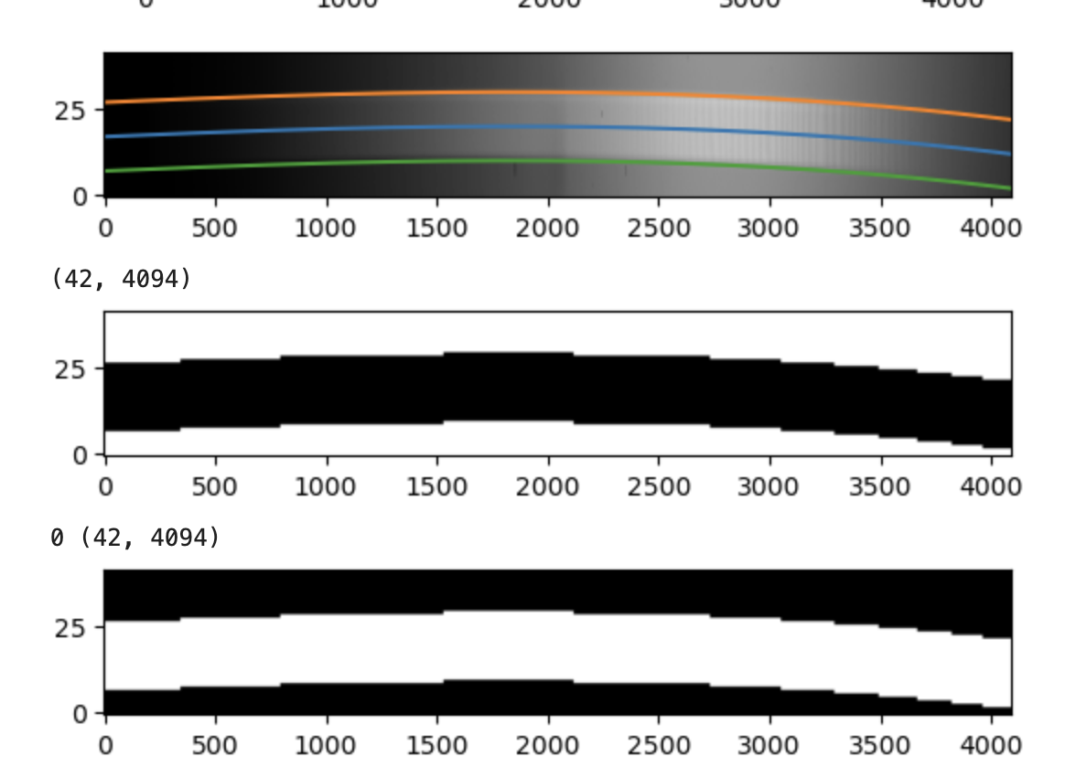
Find curvature and map traces

Slide 18
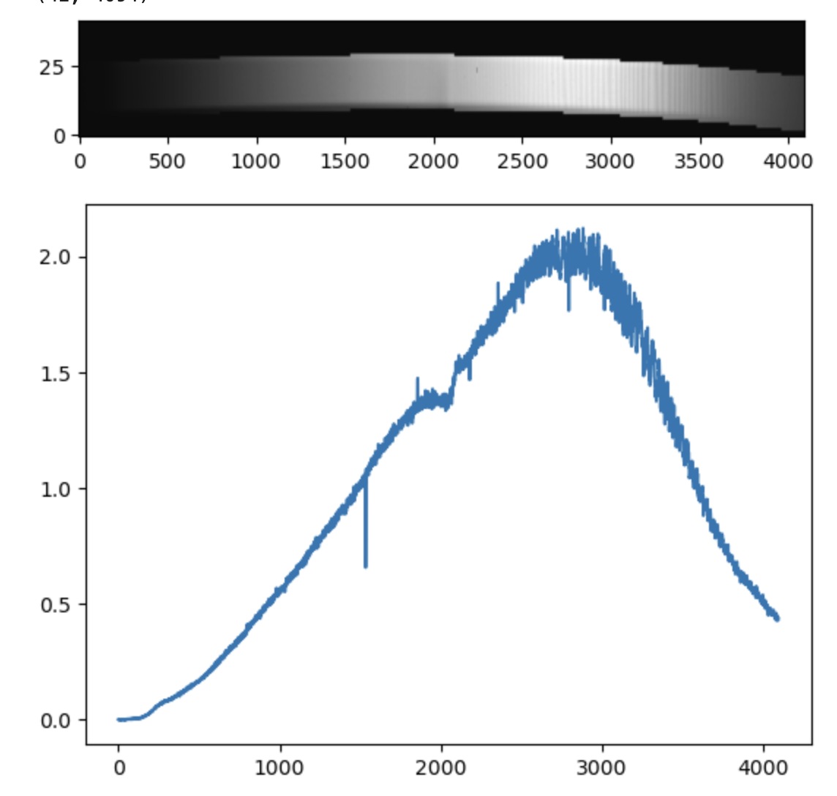
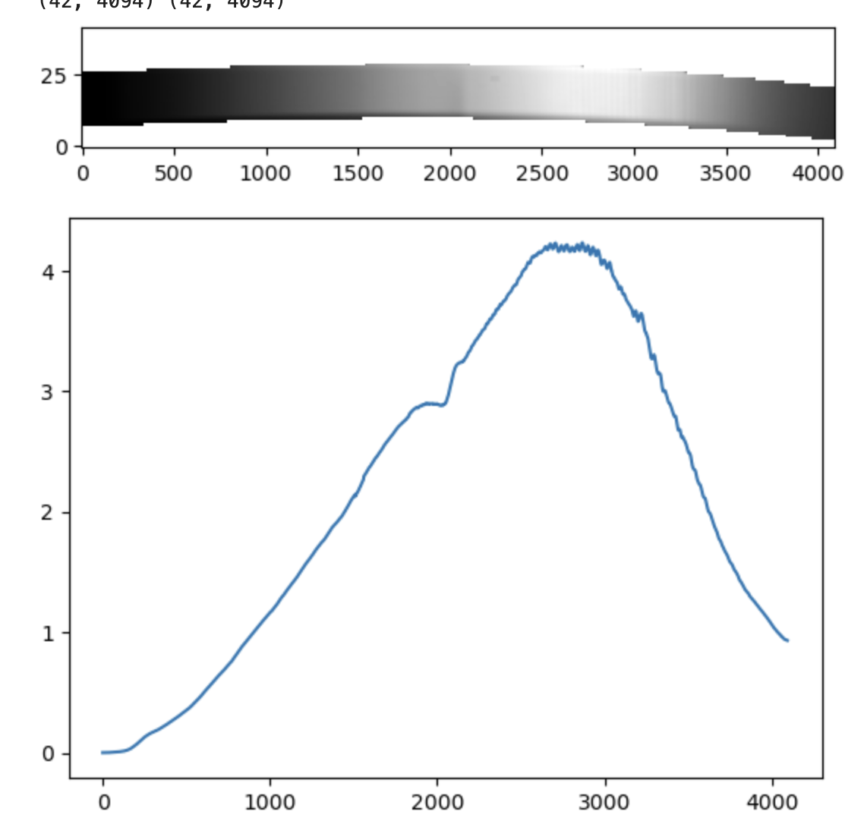
Extract Flat Field
original
smoothed

Slide 19
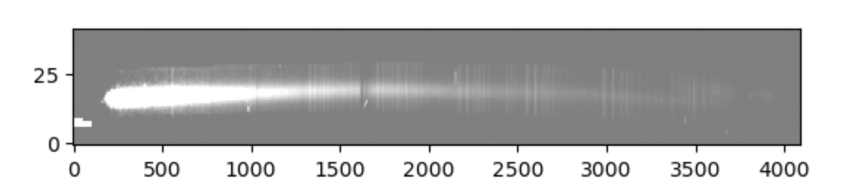
Extract stellar trace and apply flat field

Slide 20
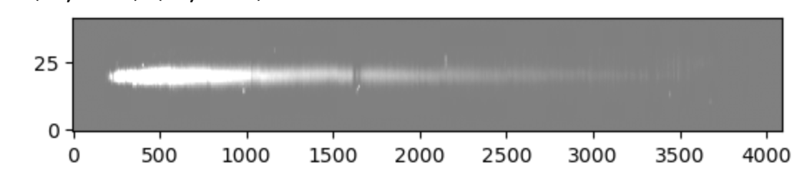
Rectify stellar spectrum

Slide 21
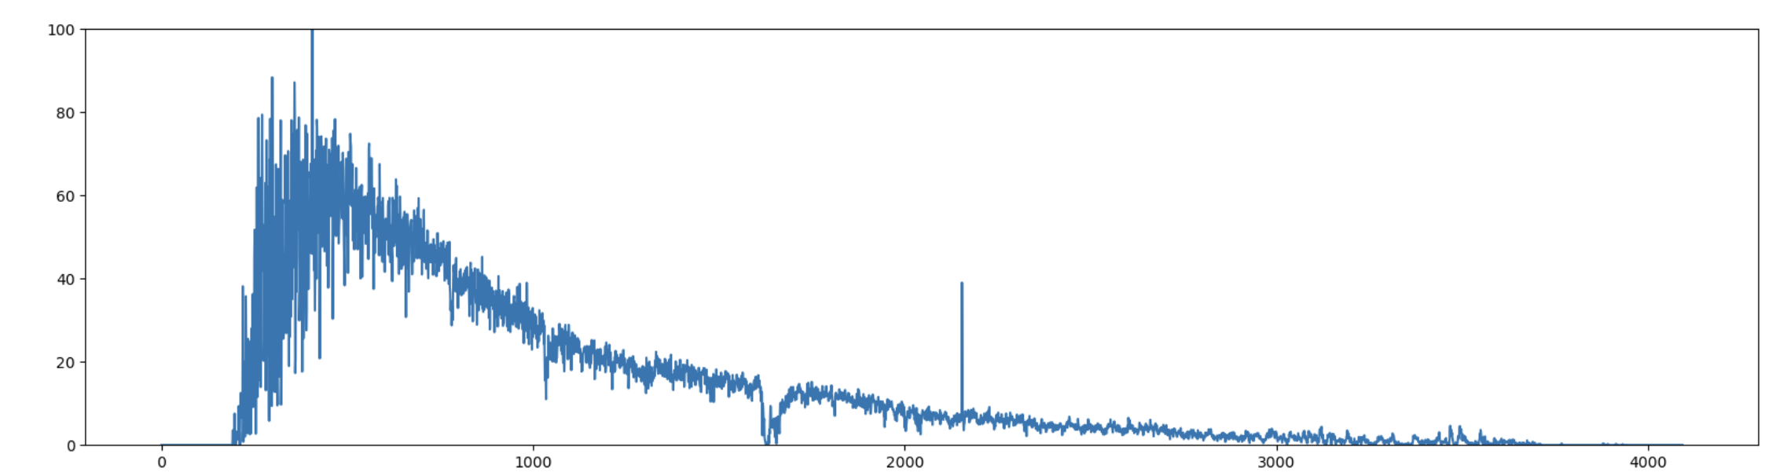
Coadd to obtain 1d spectrum

Slide 22
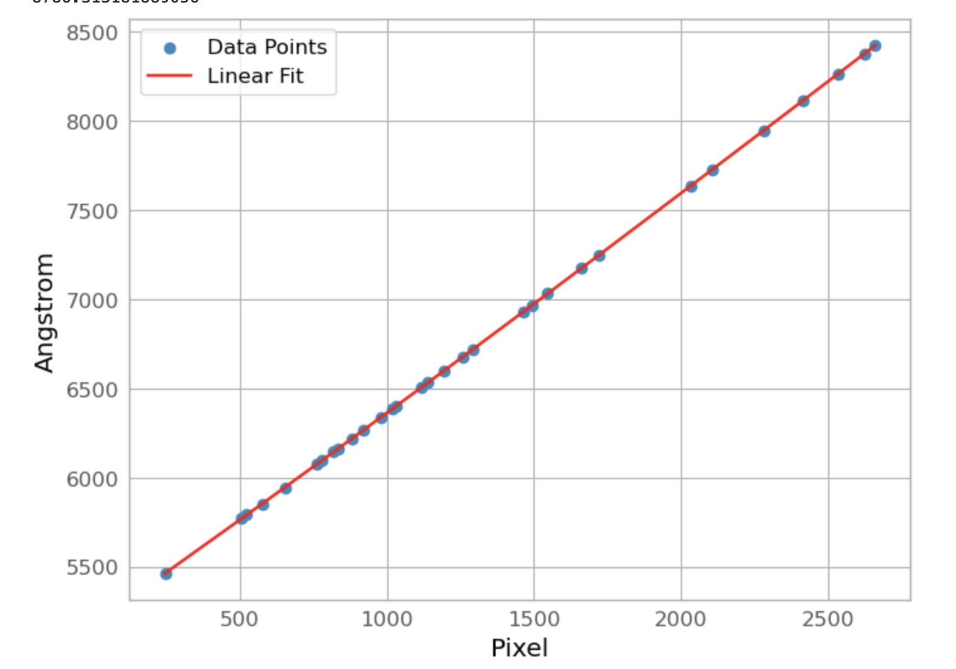
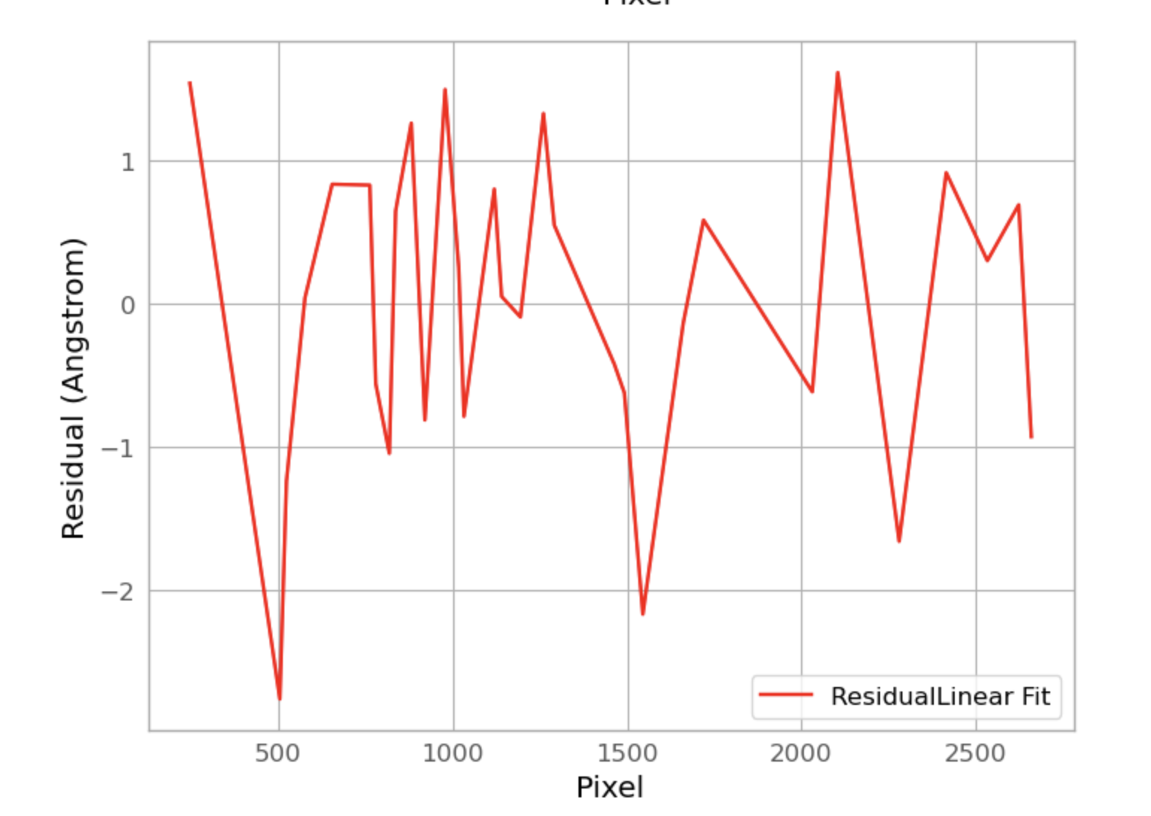
PART 3: wavelength calibration
Identify lines and fit with 3rd order polynomial. Residuals < 1 A

Slide 23
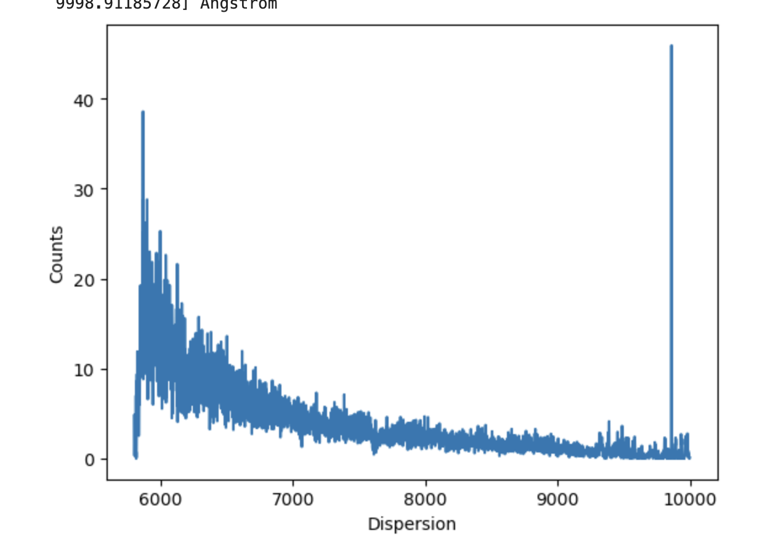
A wavelength calibrated spectrum

Slide 24
Final step
Calibration to flux, requires spectrophotometric standard

Slide 25
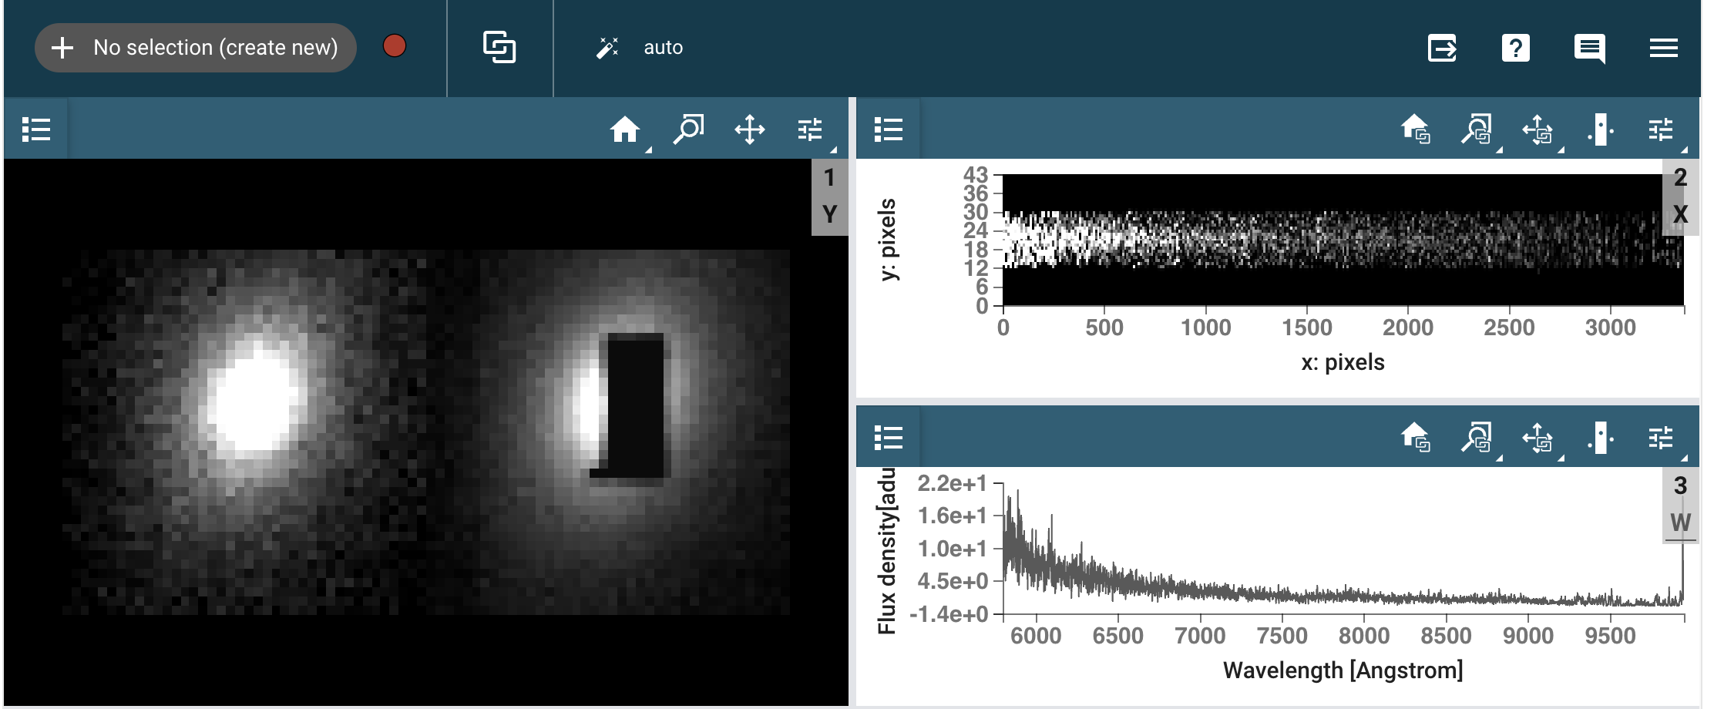
Final: put everything together in MOSViz

Slide 26
Notes:
Requires final list of slit pushed to the DMD in SIMI (x,y) pixels
Uses WCS and mapping CCD/DMD
From SISI images slit losses can be precisely estimated. It allows absolute calibration of flux of each target vs. spectrum of spectrophotometric standard

